Slide 1
IMPACTS OF sustainable tourism
Lecture 5

Slide 2
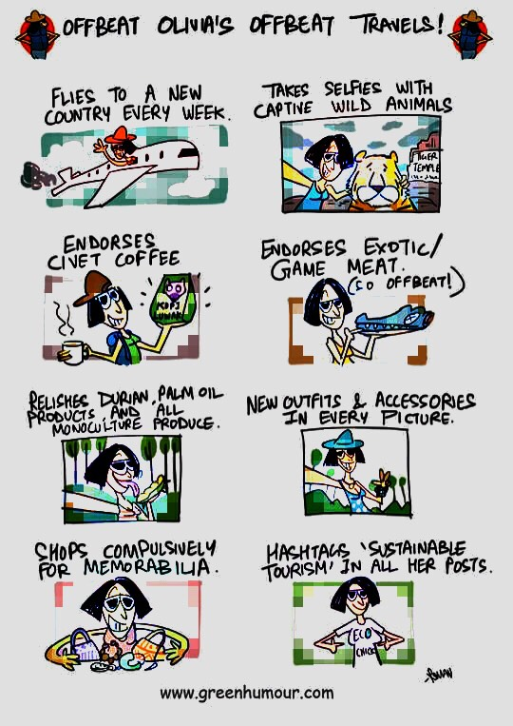
Tourism impacts
Economic Impacts
Benefits
Costs
Social and Cultural Impacts
Benefits
Costs
Environmental Impacts
Benefits
Costs
2

Slide 3
Impacts of Tourism
Difficult to disentangle the effects of tourism from the effects of human existence
Open system – therefore tourism impacts on the environment
Not a long history of studying impacts – and almost never benchmarking against pre-tourism state
Almost all studies focus on impacts at the destination, with little attention to other elements of the system
3

Slide 4
Economic Impacts
4

Slide 5
Economic Benefits
Revenue
Employment
Regional Development
5

Slide 6
Revenue
Tourism stimulates economic activity in a destination, bringing in revenue that would not have other be generated in that region
Balance of Payments (BoP)
Amount spent by international visitors to a destination, vs the amount spent by the inhabitants of that destination when they travel overseas.
Three ways to increase revenue
Longer length of stay
More visitors
Greater expenditure per visitor
6

Slide 7
Measuring tourism expenditure
Inbound tourism expenditure consists of:
What overseas visitors spend on goods and services in Australia.
Fares paid to aus. airways by overseas visitors.
Expenditure in Australia by foreign airlines attributable to the carriage of foreign visitors.
Direct Revenue
Departure taxes, Bed sales and bed taxes, Visas, Entry charges (e.g. national parks), Number of visitors/ Length of stay/ expenditure per day
Indirect Revenue
Multiplier Effect, creating local jobs through tourism’s supply chain and retaining tourism revenue locally – LINKAGES

Slide 8
Tourism employment
Tourism Employment
In Australia 929 000 people are employed in tourism directly and indirectly (8% of jobs)
High numbers of casual and part time employees in the workforce
Often unskilled or low skills
Often in the informal sector
8

Slide 9
Regional Development
Tourism can offer alternative regional development options to areas where other sectors are in decline or few other sectors exist
Ecotourism
Farm tourism
Volunteer tourism
Cultural tourism/community-based tourism
Casinos
9

Slide 10
Economic Costs
Direct costs
Indirect costs
10

Slide 11
Direct costs
Destination marketing costs
Upkeep of publicly-owned assets used by tourism, e.g. national parks
Investment in infrastructure (roads, airports, etc)

Slide 12
Indirect costs
1. Inflation
Inflationary effect on local community (e.g. land, property & goods
2. Opportunity cost
Forgo effort, time and expenditure into other industries
Tourism competes for resources with other industries
Dependency
Heavy reliance on a single industry
Seasonality
5. Income and employment
Less prestigious jobs to locals
6. Leakage
Foreign exchange generated by tourism activity may not actually benefit the economy of the destination
12

Slide 13
Indirect Costs – Continued
Leakage
Foreign exchange generated by tourism activity may not actually benefit the economy of the destination, particularly where accommodation, travel and tour organizations etc. are owned by forest investors and therefore much of the revenue leaves the destination region
13

Slide 14
SOCIO-CULTURAL IMPACTS

Slide 15
The extent and nature of socio-cultural impacts depend on 6 factors
The level of intrusive or exclusive contact between tourists and hosts
The ration of hosts to tourists
The extent of similarities between host and tourist culture and economic status
The socio-economic status and education levels of host communities
The level of dependency on tourism
The political and social makeup of the host region
15

Slide 16
Social & Cultural impacts
Two main arguments:
Tourism results in the transformation of cultural events into commercialized products or spectacles which are devoid of all meaning. Culture may be trivialized by tourism in an attempts to make it a product for tourists to consume –
cultural commodification
Vs
2. Tourism results in the protection and revitalization of traditional cultural practices by providing financial support and engendering community pride. This is seen as positively contributing to the goals of sustainable tourism –
cultural preservation
16

Slide 17
Socio-Cultural costs
Commodification and loss of authenticity
Doxey’s Irritation index
Crime
Servility theory
Demonstration effect

Slide 18
Authenticity & Commodification
Both tourists and hosts have roles to play in tourism, and these can vary between authentic and contrived
Frontstage and backstage
Host community recognizes areas within the destination that are for tourism purposes and places where they perform authentic cultural performances away from the tourists
Authenticity and/commodification can also apply to objects/events/performances:
Aesthetic, practical, uniformity and quality commodification (e.g. a cultural object changed to be easier to pack).
18

Slide 19
Servility theory & demonstration effect
Servility Theory
Involves the presentation and exploitation of the people themselves as a commodity, as demonstrated in advertisements and imagery that degrade and stereotype local people
The Demonstration effect
Local people try to imitate tourist lifestyles
Locals may resort to crime to achieve this lifestyle
19

Slide 20
Crime
Crime
Tourism lends itself to being a ‘scapegoat’ for other ills in society, since the tourism crimes are highly publicised
Tourism growth is usually accompanied by growth in residential population; hence, increases in crime may simply reflect the increases in population
Tourists can be particularly vulnerable to crime as they are unfamiliar with the local area and can stray into unsafe areas, are highly conspicuous, are in holiday mode, etc.
20

Slide 21
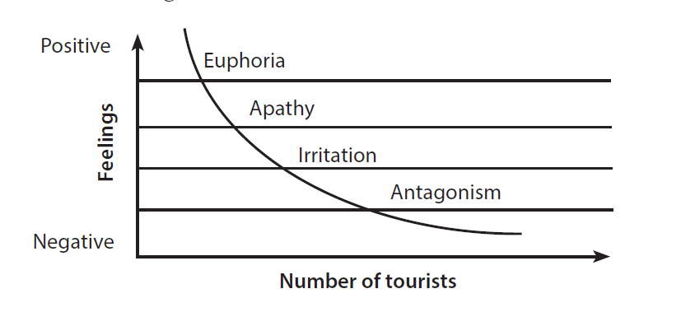
Local irritation
Doxey Irridex model suggests that the impacts will change over time
A “paradox of resentment” may also exist where limiting contact with tourists limits opportunities from tourism, but unlimited contact can drive the irridex factor
21

Slide 22
Socio-Cultural benefits
Cultural preservation
Cultural
22

Slide 23
Social & Cultural Benefits
Promotion of cross-cultural understanding
soft diplomacy
Incentive to preserve culture and heritage
Fostering of social wellbeing and stability
23

Slide 24
Alternative economies in tourism

Slide 25
ENVIRONMENTAL IMPACTS

Slide 26
Terminology to consider
Disturbance - any disruption to an ecosystem (natural or otherwise)
Incremental effects – continuous small changes which may not be noticed (by most people) until massive damage has occurred
Cumulative effects – combined stressors from various factors leading to a greater impact than might be expected

Slide 27
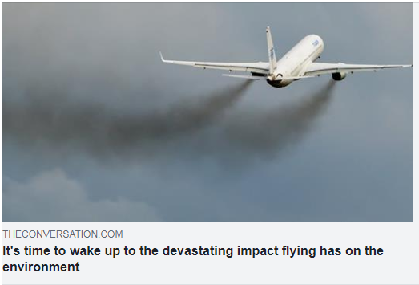
Environmental costs
Climate change
Landscape alteration
Use of resources
Waste and pollution
Impact on wildlife

Slide 28
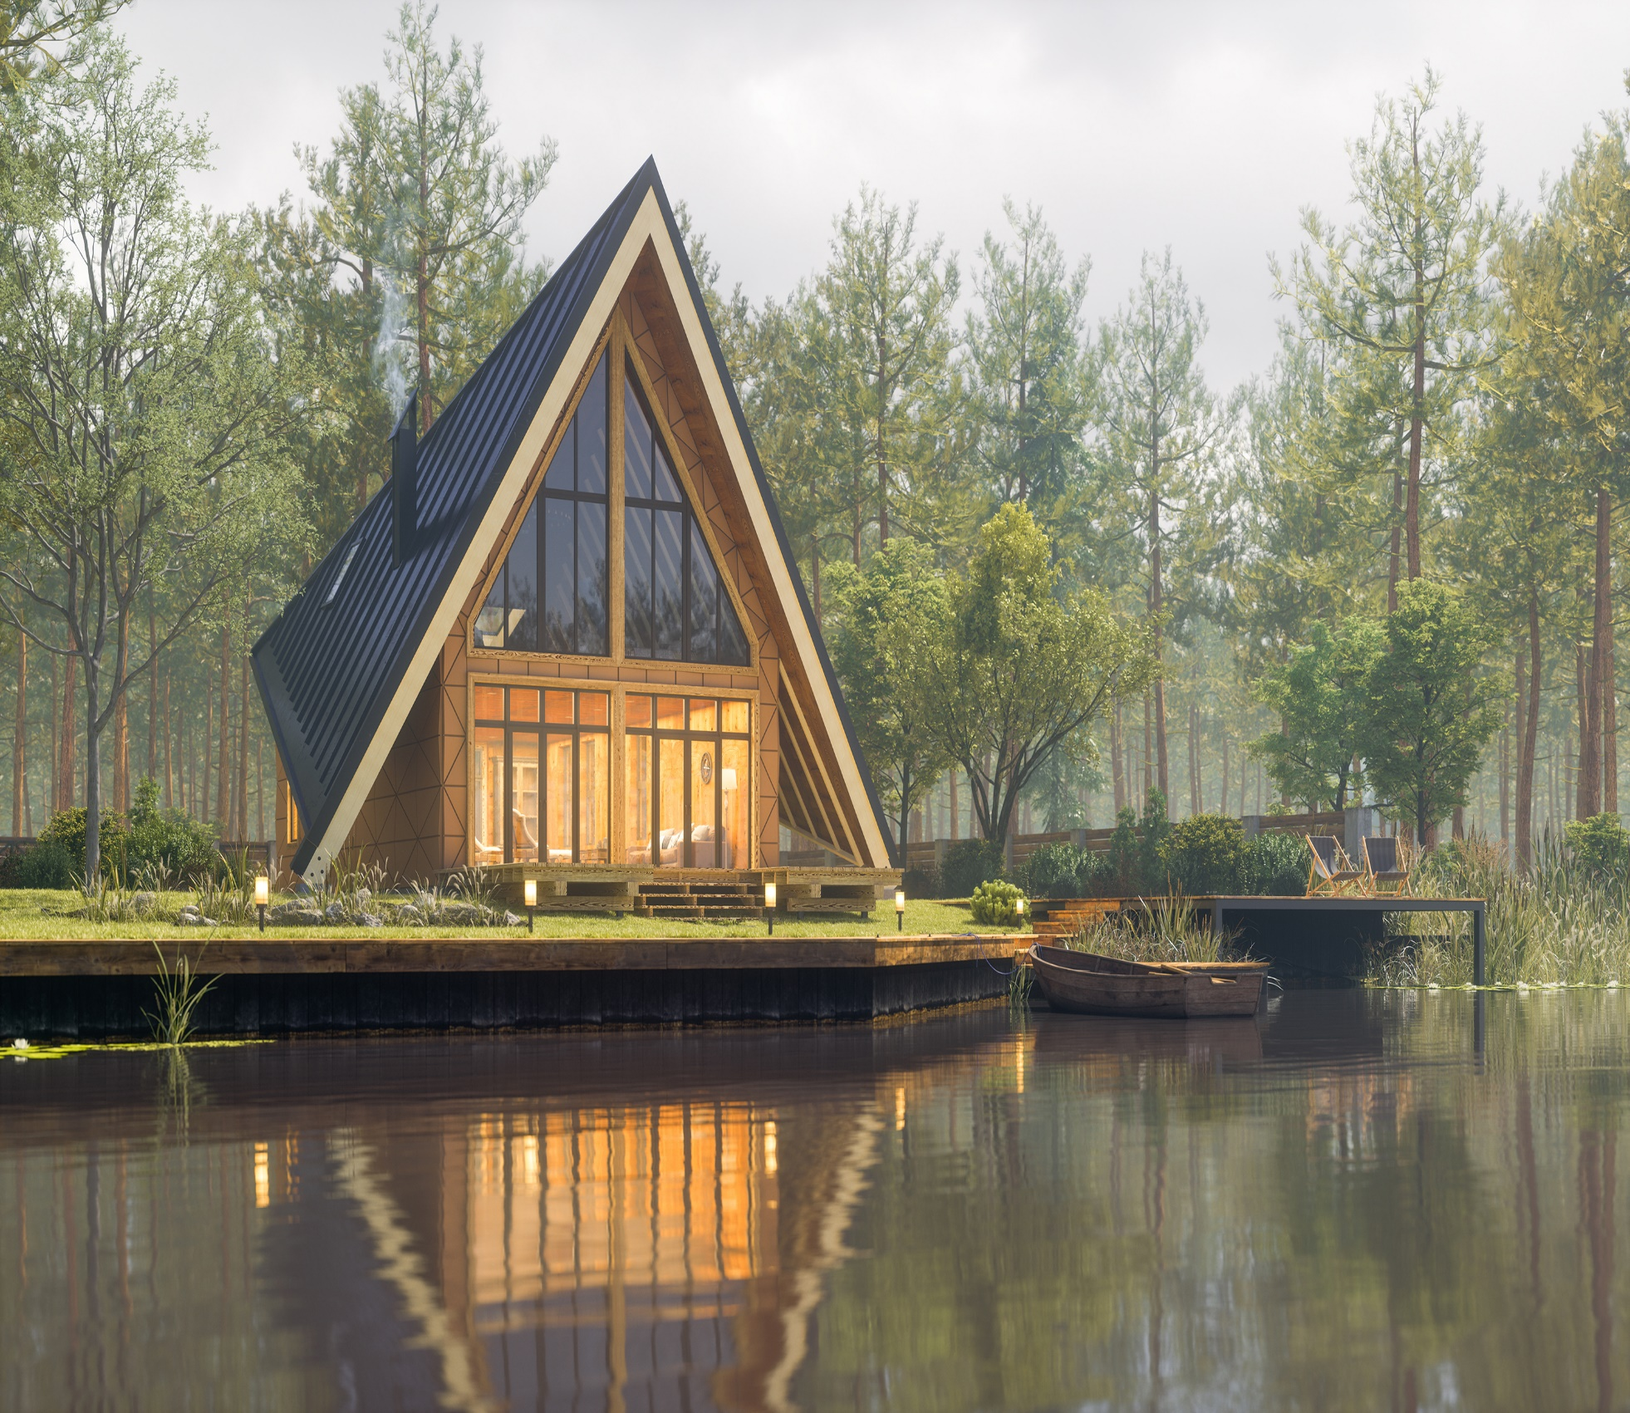
Impacts from Accommodation
In the initial development stages
Eg. clearing vegetation to build a hotel, golf course
Eg. reclaiming wetlands
Permanent restructuring
Disruption of migration
Waste and pollution

Slide 29
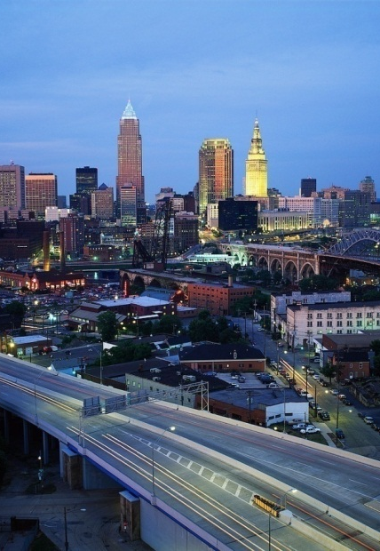
Tourism emissions
Transport (to, from, at the destination)
Destination related (accom, activities)
Transport accounts for 14% of GHG emissions
Of this:
road = 76%,
aviation = 12%

Slide 30
Impacts on wildlife
Major impacts are STRESS
and DISTURBANCE
Impacts will depend on:
Mode of access
Environmental sensitivity
Visitor pressures
Frequency of visits
Management

Slide 31
Environmental Benefits of tourism
Climate change

Slide 32
Possible benefits of tourism for the natural environment
Provides funding for maintenance
Justifies protection of sites and species
Awareness of nature by visitors
Provides jobs and incomes for indigenous people who often hold valuable information about the care of ecosystems

Slide 33
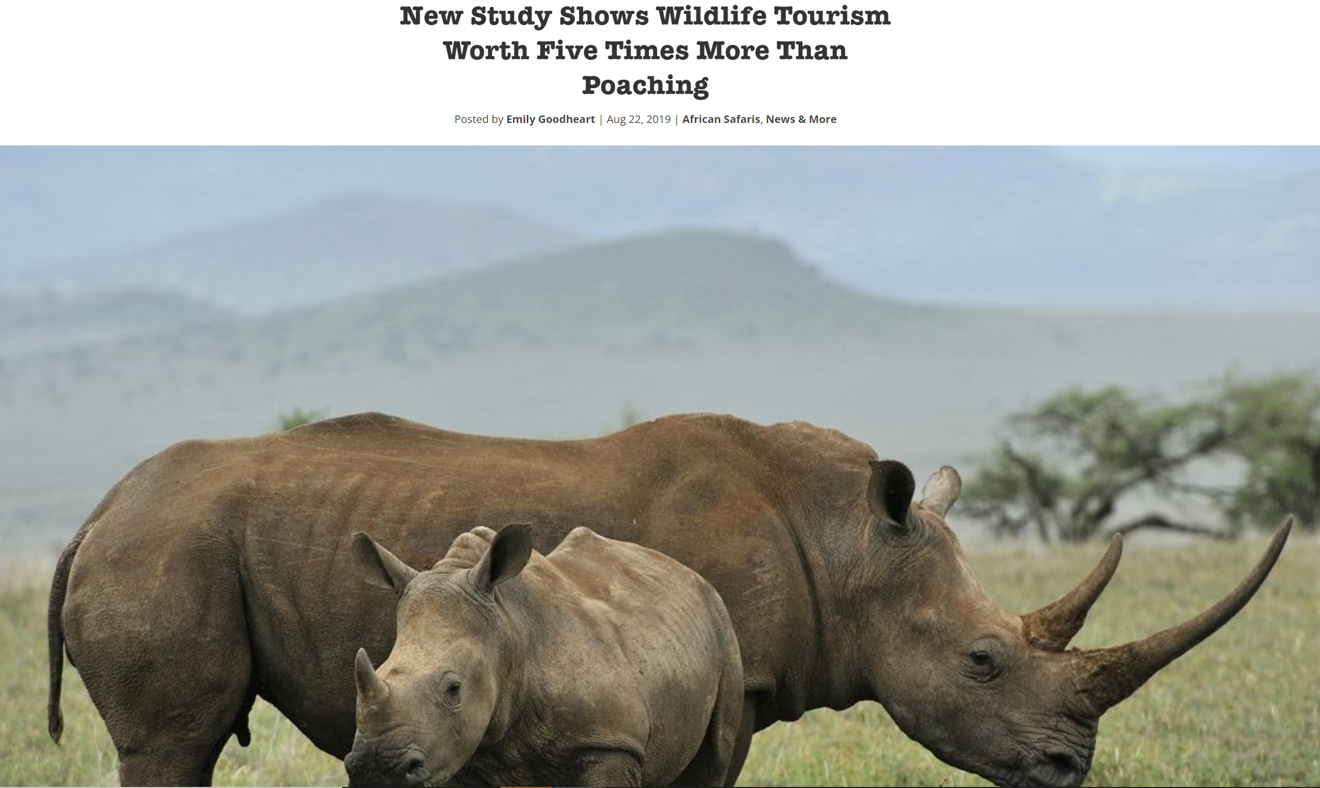
Tourism and Poaching

Slide 34
Next up…
How policies can help us manage tourism sustainably.

